Slide 1

Introduction to Programming using Python
CS.002
Notes:
Good morning everyone! So as you already heard (from the introduction) my name is Daniel Charytonowicz, I graduated WHS in 2012 so I’m not THAT much older than some of you guys. I studying engineering and computer science in college and basically today I want to show you guys a thing or two about computer programming and “coding”. So let’s get right too it as we only have so little time.

Slide 2
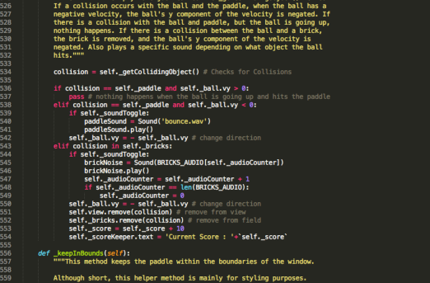
What is Code?
And how is it prevalent to today’s world?
Notes:
I’m guessing most of you have heard the words, “programming”, “code” but don’t understand what it means. I first saw this stuff in movies, with crazy bad guys typing really fast on a keyboard and writing sentences that look like abosulte gobbly-gook to me. The reality can’t be further from this; programming/coding, which are really the same thing is very easy to do. The hard part comes when you have to come up with WHAT to program.
What I’m going to show you today is a basic introduction in HOW to program with the hopes that some of youj will continue to learn on your own. By learning how to code you will have a tool to create anything that you want.

Slide 3
Code
010101001001011100101001010101010101010100111010101100111000110100111001010101100110110000011010010010101000100110011001001001100
Binary
mov abx3e321, e32
mov 324aev,231fba1
eax f2va33,ffa3a34
edx 249gjfa,23f2fa
Assembly
number = 30
number = number * 30
aCopy = number
print aCopy
Python
Notes:
Python is a simple and easy way to tell our computer what we want it to do.

Slide 4




Starting / Using SublimeText 3
To Start SublimeText 3
Click the windows Start button, the start menu will appear
Click on the SublimeText 3 Quick-Launch Icon
To begin using SublimeText 3
Click File -> New File (Ctrl+N)
Save the new file
Click File -> Save (Ctrl+S)
Save the file as HellowWord.py in your project folder
Now let’s write our first program!

Slide 5
Part One
Variables, Assignment, and Conditionals

Slide 6
Variables and Assignment
Value
=
Variable
The “value” is the result of any calculation done on the right side of the “assignment” operator.
Ex: 30 + 30 (value is 60)
15 * 2 (value is 30)
The “variable” can be called anything (x,y,z, apple,orange). The variable “holds” the value calculated on the right side of the assignment operator.
Assignment, NOT equals!
aValue = 30
This is the variable
“Assignment” Operator
This is the value

Slide 7
Variables and Assignment
Operation
number = 30
number = 15 * 2
number = 30 – 15
number = 3 ** 3
number = 2 ** (2 + 3)
aValue = 5
number = aValue * 3
number = aValue + 15
number = 10
number = number ** 2
Evaluation
number -> 30
number -> 30
number -> 15
number -> 27
number -> 2 ** (5) -> 32
aValue = 5
number -> (5) * 3 -> 15
number = (15) + 15 -> 30
number -> 10
number -> (10) ** 2 -> 100
The calculation of the value to be assigned to the variable follows PEMDAS rules.
A value calculation can include other variables (using their stored value), in fact a calculation can include the variables current value, which will be changed to the new value following assignment.

Slide 8
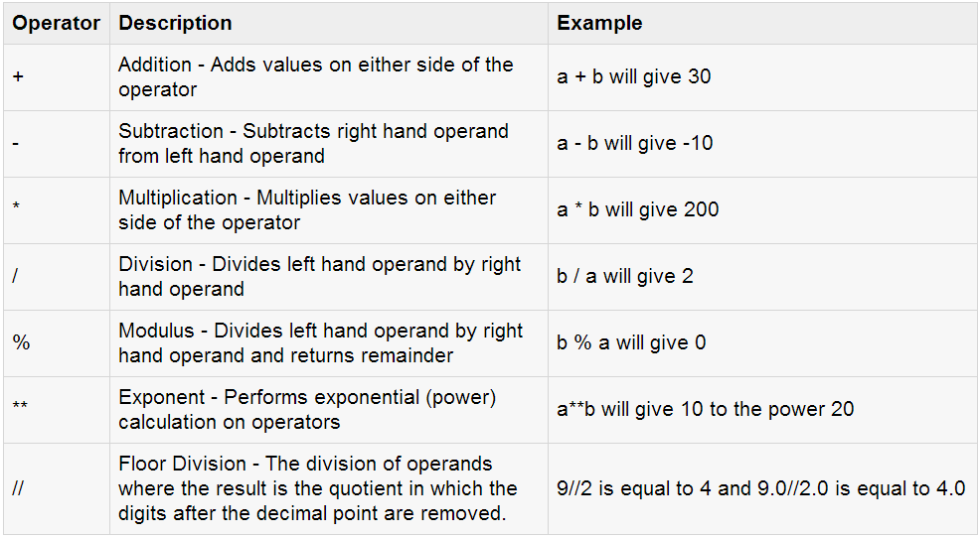
Arithmetic Operations
Assume variable a holds 10 and variable b holds 20, then:

Slide 9
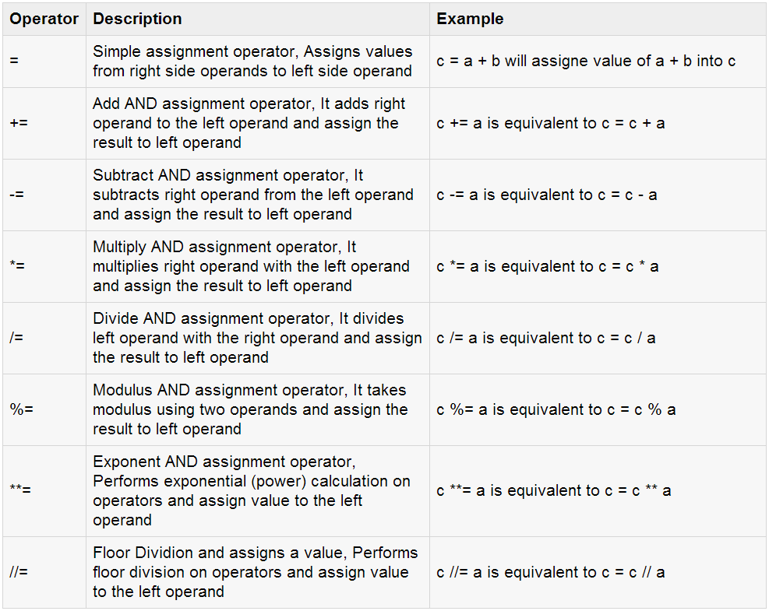
Advanced Assignment Operators

Slide 10
Now Try This Yourself
Remember to include a print statement:
If you want python to output the variable “aValue” (can be called anything…)
Type:
print aValue

Slide 11
Controlling Assignment Conditionals
if
Conditional Is True
:
Run Code Block
Tab
The Assignment
The Conditional
The equation in here is known as a logic operation. All conditionals will either be True or False.
If true, the program runs the code block, otherwise it skips it.
number = 0
if (number == 0):
aCopy = 10
number = aCopy * 2
print number
The print statement.
Ex:
print variable
Tab

Slide 12
Controlling Assignment Conditionals
Types of Conditions
== Equals
!= Not Equals
> Greater Than
< Less Than
The Left Value
The Right Value
If ( 5 * 3 > aValue ) :
Each side of the conditional statement is calculated exactly like the right side of an assignment of operation. The resulting values on each side are compared to one another according to the type of condition imposed (==, != , > , < ) and returns either True or False.
The Condition
15 == 15 True
15 == 16 False
3 + 4 == 7 True
8 != 7 True
98 > (3*15) True
if

Slide 13
Now Try This Yourself

Slide 14
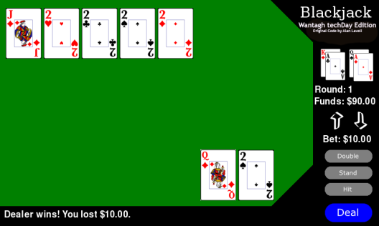
A Practical Application Blackjack
Blackjack is a simple card game. See the provided rule sheet.
Each of you has your own copy of the games python code in your personal folder.
There are two “bugs” in the games code. Let’s use what we’ve learned thus far to fix the first one.
Scroll to line 534

Slide 15
A Practical Application Blackjack A Broken “Bet Button”
Run the game (CTRL+B)
Note that the bet buttons don’t work (when you click them the amount of money being bet doesn’t go up or down)
Think about the steps needed to raise a bet:
1. Check to see if your bet is less than the total money available
2. If (1) is true, increase the bet by a certain amount.
Think about the steps needed to lower a bet:
1. A bet cannot be negative, how would you check this using conditionals?
Assuming (1) is true, decrease the bet by a certain amount.

Slide 16
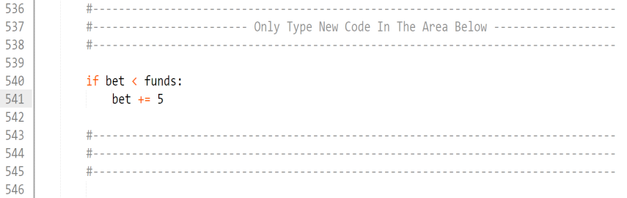
A Practical Application Blackjack A Broken “Bet Button”
Raising the bet.

Slide 17
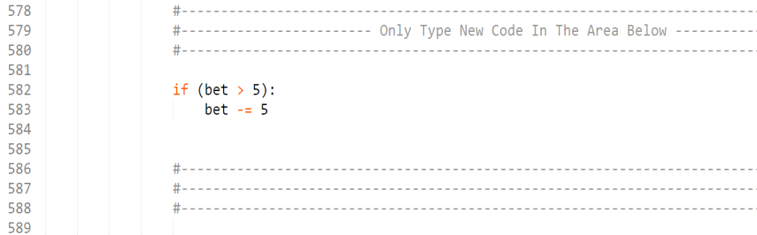
A Practical Application Blackjack A Broken “Bet Button”
Lowering the bet.

Slide 18
Part Two
Strings, Lists, and Loops
Notes:
Good morning everyone! So as you already heard (from the introduction) my name is Daniel Charytonowicz, I graduated WHS in 2012 so I’m not THAT much older than some of you guys. I studying engineering and computer science in college and basically today I want to show you guys a thing or two about computer programming and “coding”. So let’s get right too it as we only have so little time.

Slide 19
Strings
A variable can store things besides numbers as its value.
Text, lists, etc… (we will get to this last one in a few minutes)
A string is a value that holds text, which can be a single letter or an entire paragraph.
A string is made simply by putting “ “ around a word or phrase.
Ex: “This is a string” can be assigned to a variable like a number.
aString
=
“This is a string.”
A Variable
Assignment, NOT equals!
A String

Slide 20
Strings
What can string be used for?
Combine with conditionals and print commands to allow the program to give feedback to the user.
How can we manipulate strings?
Strings can be added together.
Ex: aStr = “The cat” + “ in the hat.” = “The cat in the hat.”
Strings cannot be subtracted from one another.
String Examples:
“a” A single character string.
“123213” Numbers can be strings too.
“Daniel” A name.
“Sentence’s can be strings too.” A sentence.
.

Slide 21
Now Try This Yourself

Slide 22
Lists
A variable can store things besides numbers as its value.
Lists, text , etc… (we already covered the second one)
A list is a collection of a bunch of similar items (numbers, strings, etc…).
A list is made by putting a series of values (numbers or strings) together inside brackets [ ], separated by commas.
aList
=
[10,12,13,14,2]
A Variable
Assignment, NOT equals!
A List

Slide 23
Lists
Examples of Lists
myList = [3,4,1,63,12] List of Numbers
myList = [“aString”,”anotherString”] List of Strings
myList = [anotherList,anotherList2] List of Lists
Adding and item to a list:
myList.append(item)
Removing an item from a list:
myList.remove(item)
Combining Lists:
Given aList = [1,2,3] and aList2 = [4,5,6]
sumList = aList + aList2 = [1,2,3,4,5,6]
How do we access items that we put in our list?

Slide 24
Lists
Indexing
A list holds a collection of items, each of which is in a specific position within a list.
You can retrieve items from a list through a process called Indexing.
aList[position] will return the value stored at aList’s position
Positions start at 0
aList
=
[10,12,13,14,2]
aList[2] -> 13
Position: 0 1 2 3 4

Slide 25
Now Try This Yourself

Slide 26
Loops
A loop is a powerful way to repeat the same block of code multiple times.
Two important types of loop:
While Loop For Loop
while
Conditional True
for x in List:
Run Code Block
Run Code Block
Tab
Tab
A while loop is similar to an if statement in that the code block will keep repeating while the given conditional is still true.
A for loop will run the code block once for every value in a List. For any given cycle of the code block, x holds the current list value.

Slide 27
Loops
Example of a while loop:
Assign 0 to the variable x
x = 0
aString = “”
while (x < 4):
aString += “ good morning!”
x += 1
print aString
Create an empty string aString
While the value of x is less than 4 keep repeating the code block
Tab
Add “good morning” to the end of aString
Increase the value of x by 1
Print the result
Result: “ good morning! Good morning! Good morning! Good morning!”

Slide 28
Loops
What is the range(n) function?
In python, typing range(n) where n is a number will give you a List of Elements starting from 0 and going up by one (1,2,3,etc…) until one less than n.
Ex: range(5) == [0,1,2,3,4]
This is an easy and commonly used way to make lists for for loops.
Example of a for loop:
for x in range(0,5):
print (2 * x)
The variable x will cycle through the range 0 to 4
The range here is: 0,1,2,3,4
Tab
Result: 0 2 4 6 8

Slide 29
Now Try This Yourself

Slide 30
A Practical Application Blackjack An improper deck of cards
Run the game (CTRL+B)
Note that of the cards being “dealt”, there are no numbered cards? Also, where are the diamond cards?
Scroll to line 114
Note that the diamond cards are all missing?
Note that of the cards being “dealt”, there are no numbered cards. There are only royal spade, club and heart cards.
Lets fix this!

Slide 31
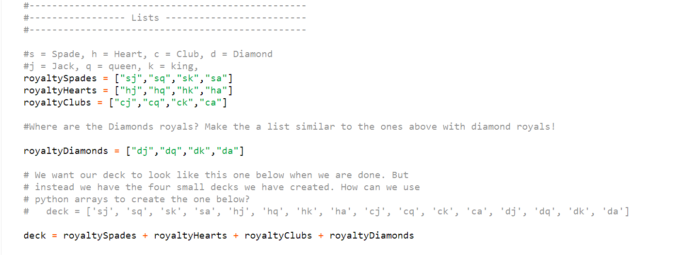
A Practical Application Blackjack An improper deck of cards

Slide 32
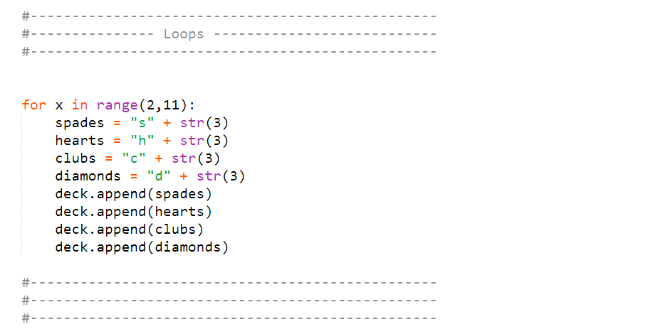
A Practical Application Blackjack An improper deck of cards

Slide 33
Part Three
Review and Turtles

Slide 34
Review Any Questions?

Slide 35

Turtle
What is a turtle?
A little “arrow” whose movement can be controlled.
Turtle Controls:
Movement (<distance> is a number in pixels)
turtle.forward(<distance>)
turtle.backward(<distance>)
turtle.left(<degrees>)
turtle.right(<degrees>)
Special
turtle.clear() Clears the turtle screen
turtle.up() “Picks Up” pen so turtle won’t draw line
turtle.down() “Puts Down” pen so turtle will draw line
turtle.home() Brings the turtle back to its original position

Slide 36
Turtle
Let’s try playing with some of these commands!
Open turtleBlank.py which is found in your techDay student folder!
Go to File -> Save As:
Rename and re-save the file as turtleTest1.py in your techDay student folder.
Each time you want to make a new turtle drawing, remember to resave the file under a new name (ex: turtleTest2.py).
Remember to only add turtle action code in the appropriate spaces, the other lines of code are there to make sure turtle works properly!
Notes:
Found in their student share folder.

Slide 37
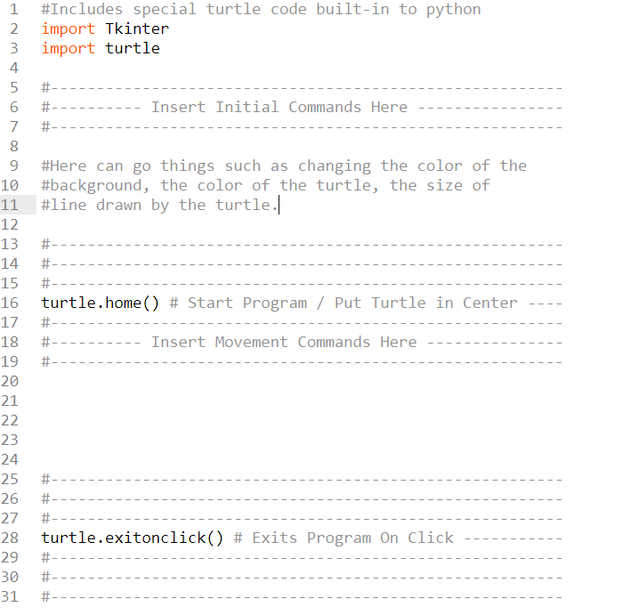
Turtle
Notes:
Found in their student share folder.

Slide 38
Turtle Challenges
Go to your techDay student folder. You will find a document called turtleChallenges.pdf which contains the instructions and tutorial guides for each challenge. Follow along as best as you can, if you get stuck refer to the tutorial documentation, or ask one of us for help!
Good luck!

